Slide 1



SOLID Principles
in C#
Presented to:
Parth Shukla Sir
Presented by:
Giridhar Gopal

Slide 2

Introduction to Solid Principles:
SOLID principles are a set of 5 design guidelines in object-oriented programming (OOP) that help developers build robust, maintainable, and scalable software systems.
These principles were introduced by Robert C. Martin (also known as Uncle Bob), a well-known software engineer and author.
SOLID principles are widely used in modern programming languages such as C#, Java, Python, and C++.

Slide 3
S
Single Responsibility Principle
What is SOLID ?
O
Open/Closed Principle
L
Liskov Substitution Principle
I
Interface Segregation Principle
D
Dependency Inversion Principle

Slide 4
S — Single Responsibility Principle (SRP)
Definition :
A class should have only one responsibility (one job)
A class should have only one reason to change
Avoid combining multiple functionalities in a single class
Key Idea :
Separation of concerns
Each class focuses on one specific task

Slide 5
O — Open/Closed Principle (OCP)
Definition:
Classes should be:
Open for extension (you can add new features)
Closed for modification (don’t change existing code)
Key Idea:
Use inheritance / interfaces
Avoid modifying existing working code

Slide 6
L — Liskov Substitution Principle (LSP)
Definition :
A child class should be able to replace its parent class
Without breaking the program behavior
Key Idea :
Inheritance should not change expected behavior

Slide 7
I — Interface Segregation Principle (ISP)
Definition :
A class should not be forced to implement methods it does not use
Prefer multiple small interfaces instead of one large interface
Key Idea :
Avoid “fat interfaces”
Keep interfaces specific and minimal

Slide 8
D — Dependency Inversion Principle (DIP)
Definition :
High-level modules should not depend on low-level modules
Both should depend on abstractions (interfaces)
Key Idea :
Use interfaces instead of concrete classes
Promotes loose coupling

Slide 9

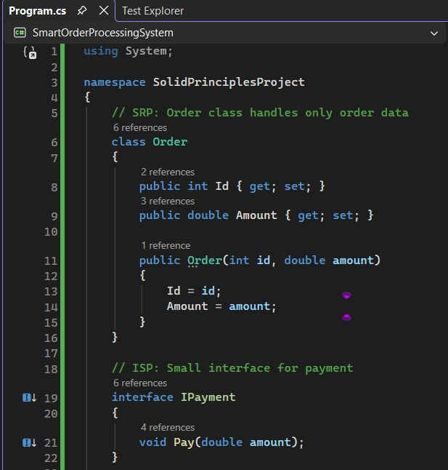
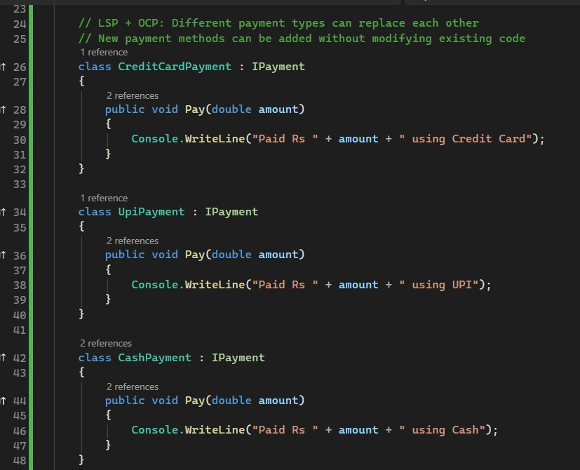
A C# project demonstrating all five SOLID principles using a
Smart Order Processing System.

Slide 10
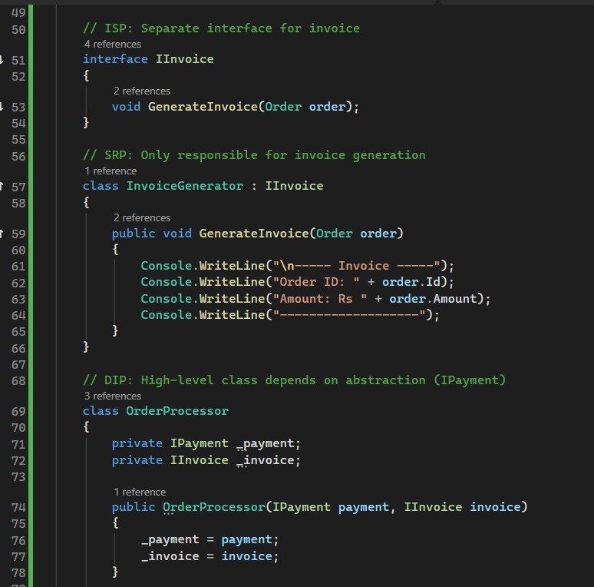
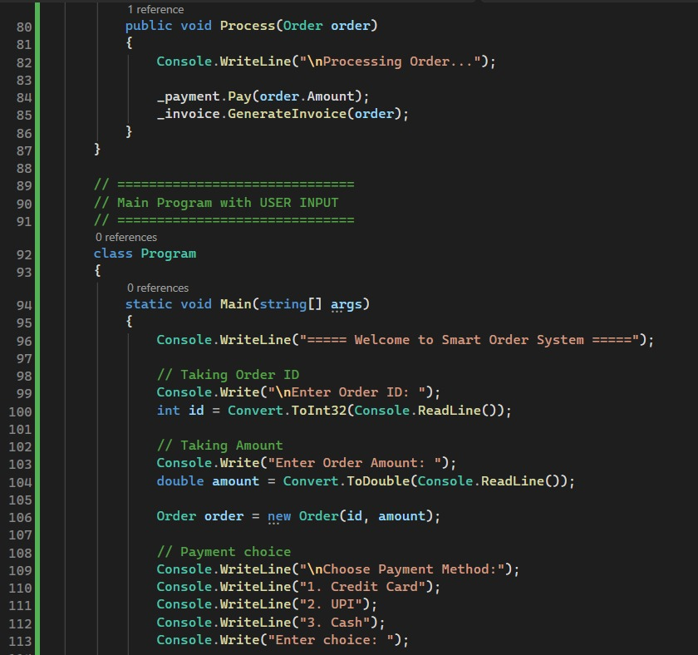

Slide 11
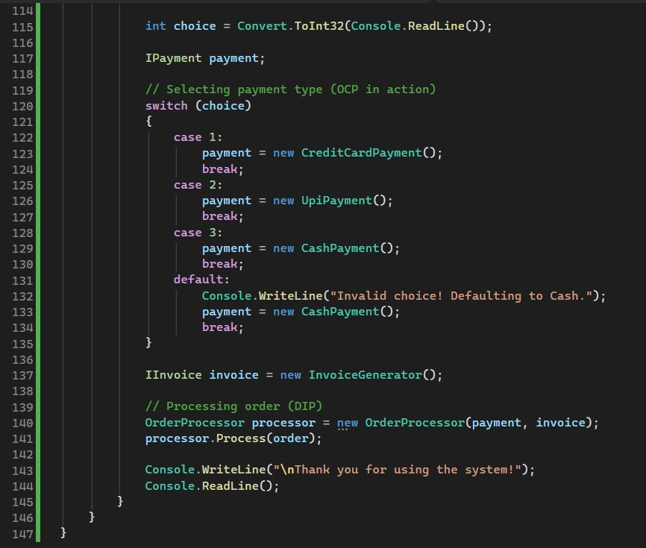
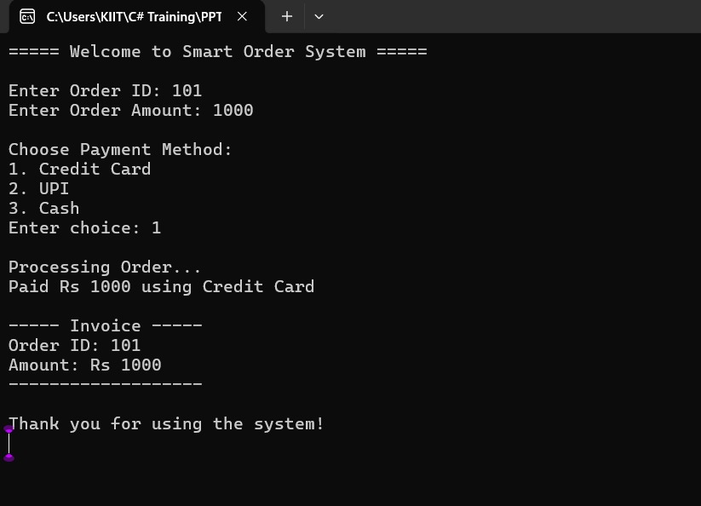
OUTPUT

Slide 12
Conclusion:
The project demonstrates all 5 SOLID principles in a practical way
Each component has a clear and single responsibility
System is flexible and easy to extend (new features can be added easily)
Code is loosely coupled using interfaces
Improves maintainability, readability, and scalability
User input makes the application interactive and realistic

Slide 13
Thank You!

Slide 14



